Slide 1


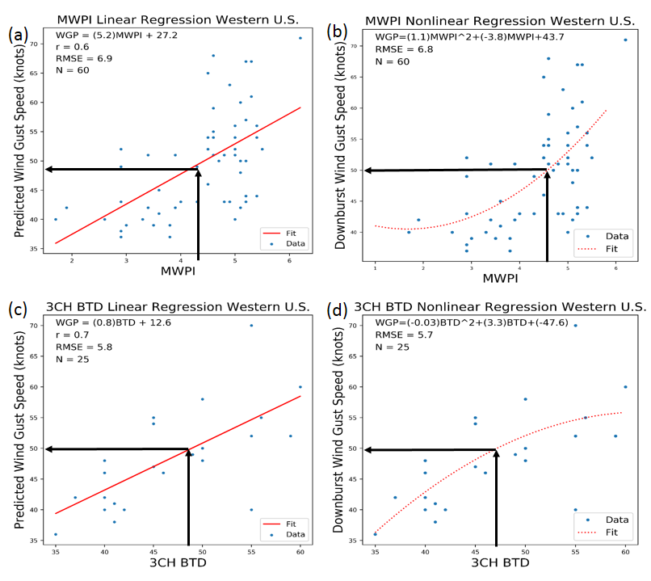
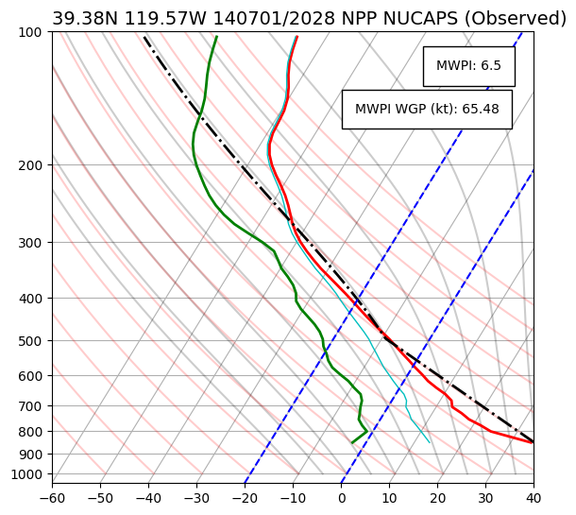
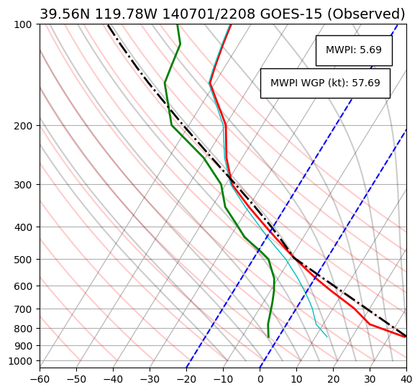
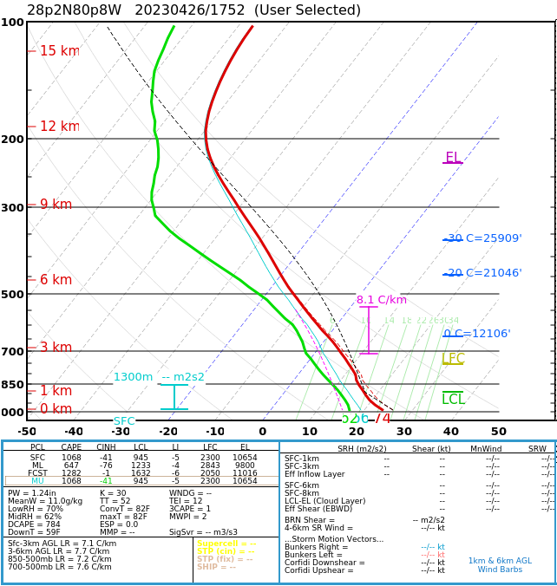
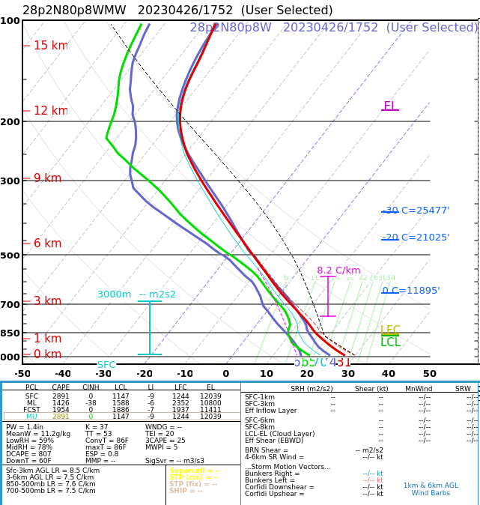
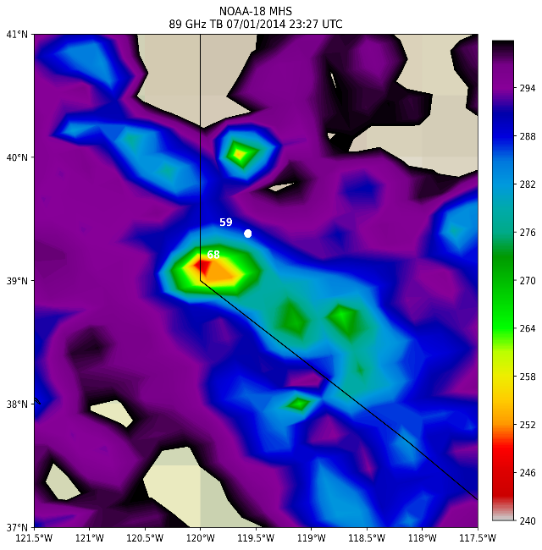
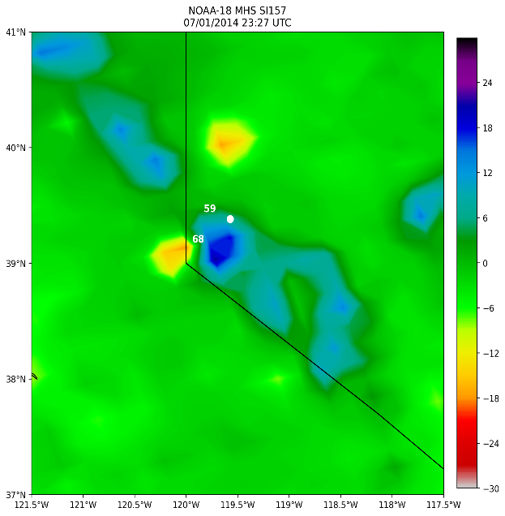
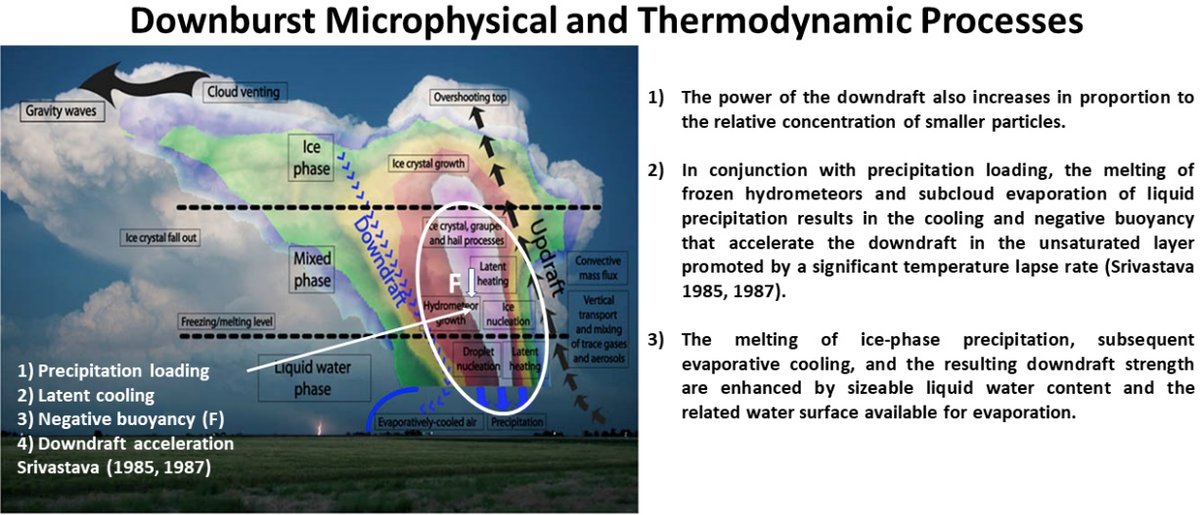
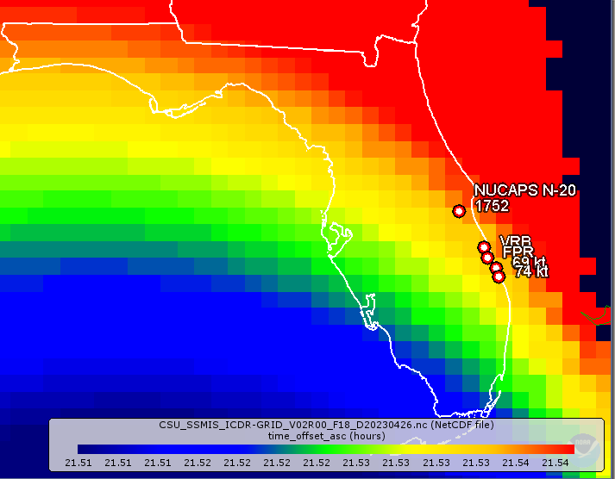
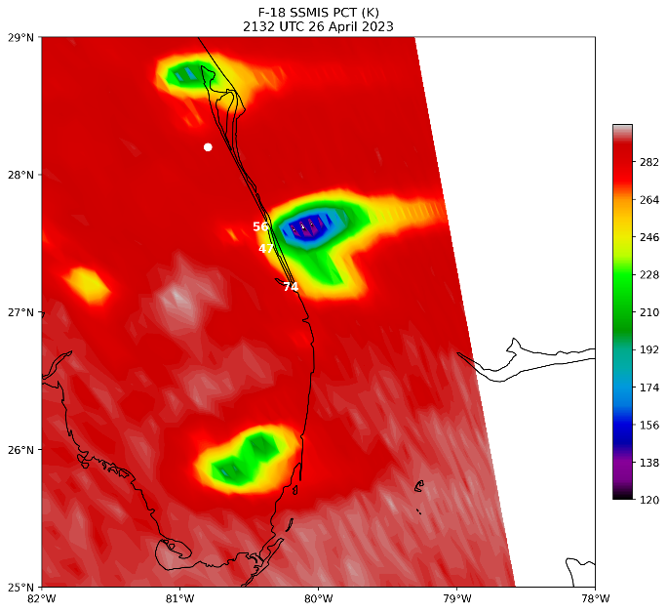
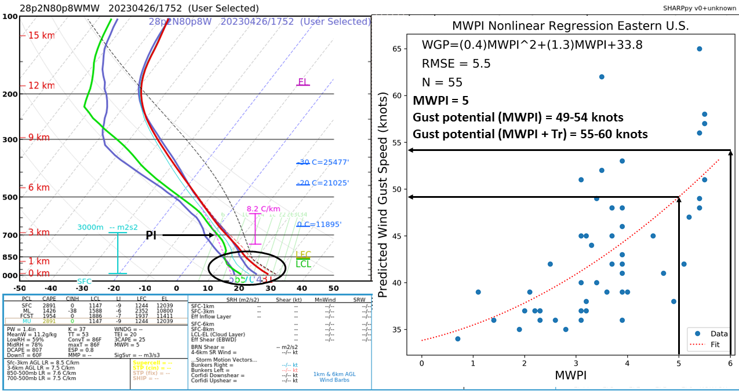
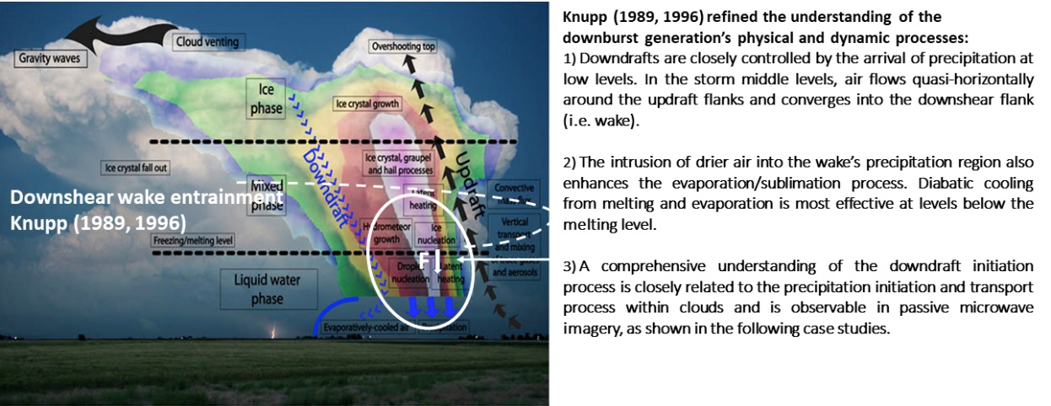
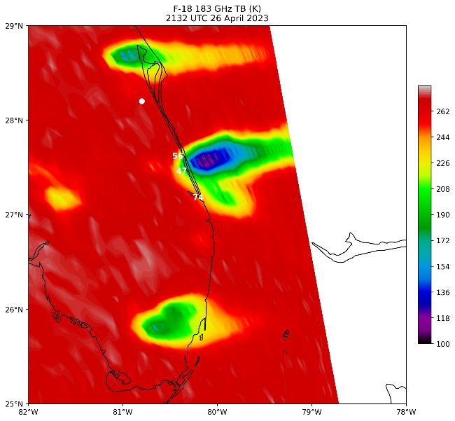
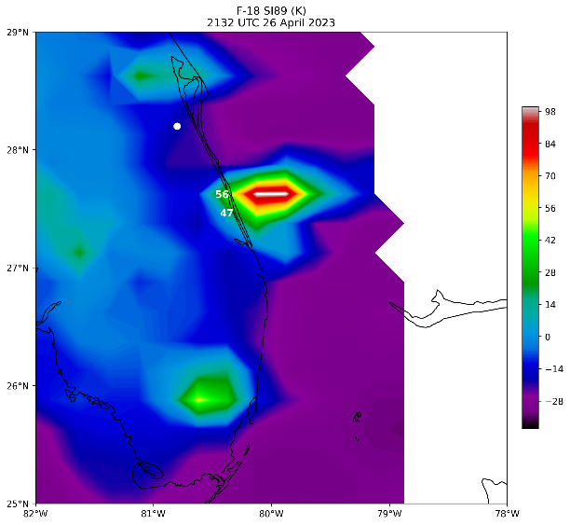
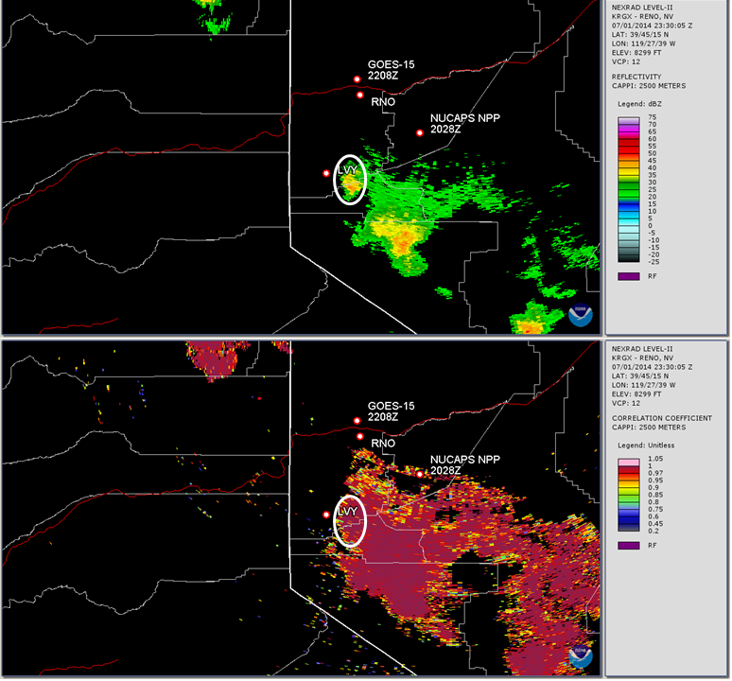
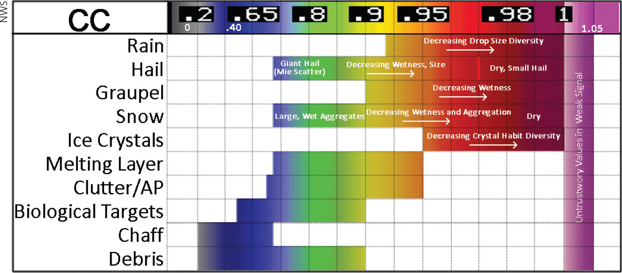
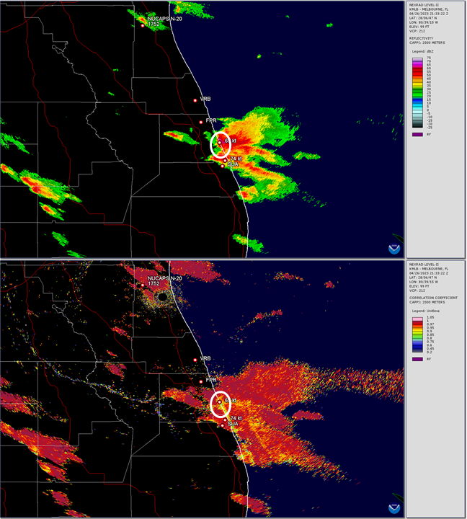
The Microburst Windspeed Potential Index:
Applications for Post-storm Surveys and Forensic Reviews
Kenneth Pryor¹, Daniel Schreiber²
¹NOAA/NESDIS Center for Satellite Applications and Research (STAR), College Park, Maryland
²J.S. Held, LLC, San Antonio, Texas
Historically, downburst research and damage surveys have been limited to damage assessments, review of nearby wind measurements and estimations, and weather radar review. While each of these methods can also be used for forensic, post-storm analysis, the focus of this study is on the applications of the highly adaptable Microburst Windsped Potential Index (“MWPI”) to different storm modes within different climate regimes and different geographies.
DATA AND METHODOLOGY:
SATELLITE, RADAR, AND DIAGNOSTIC ANALYSIS
CASE 1: JULY 2014 WESTERN NEVADA
DRY DOWNBURST EVENT
CASE 2: APRIL 2023 SPACE TO TREASURE COAST FLORIDA SUPERCELL EVENT
DISCUSSION AND CONCLUSIONS
MWPI-wind gust potential regression charts and attendant regression equations are derived by direct comparison between calculated MWPI values and associated proximate measured downburst wind gust speeds.
The NOAA-Unique Combined Atmospheric Processing System (NUCAPS) is an enterprise algorithm that retrieves atmospheric profile environmental data records (EDRs), and is applied and evaluated for both a daytime and nocturnal severe convective windstorm cases. NUCAPS is also the primary algorithm for the operational hyperspectral thermal IR and microwave sounders.
A dry microburst occurred near Carson City on the afternoon of 1 July 2014, resulting in a measured significant severe wind gust of 68 knots (78 mph) at the Little Valley remote automated weather station (RAWS) at about 6,500 feet above sea level. This storm produced an outflow boundary which travelled into Reno, resulting in severe wind gusts, including a 59 knot (68 mph) wind gust at Reno-Tahoe Airport and a 62 knot (71 mph) wind gust at the Reno NWS office. Shortly after this event, the outflow boundary remained active, generating severe-caliber winds in the Truckee Meadows area.
A long-track supercell thunderstorm moved across Brevard, Indian
River, St. Lucie, and Martin Counties Florida on the afternoon and
evening of 26 April 2023. This supercell resulted in several reports
of significant-severe wind gusts and surveyed wind damages,
published in the NOAA Storm Events Database. This storm resulted in an area of damage in West Melbourne (Brevard County) in which the National Weather Service (NWS) determined was between 70-75 miles per hour (mph). Specifically mentioned within this damage survey was a nearby measured wind report from a personal weather station (PWS) of 62 knots (71 mph).
In general, afternoon NPP and NOAA-20 NUCAPS soundings qualitatively indicate a strong signal for severe thunderstorm and downburst occurrence:
Close agreement between the boundary layer structure ("inverted-V") as resolved by the GOES and NUCAPS soundings profiles and the calculated MWPI gust potential.
Strong relationship between high radar reflectivity and very low MW brightness temperatures (BTs) apparent in NOAA-18 and F-18 satellite overpasses.
Low BTs also correspond well with the high integrated graupel values, suggesting that intense downdrafts and resulting downbursts were forced by ice precipitation loading and melting, as well as unsaturated air entrainment into the mixed-phase precipitation core.
NEXRAD correlation coefficient product effectively distinguished between dry graupel, small hail and ice crystal aggregates that were predominant in the western Nevada downburst storm and the presence of larger, melting graupel and hail that was prevalent in the Florida supercell storms. Accordingly, the Florida storms exhibited an increased favorability for severe downburst generation.
Figure 2. MWPI downburst wind gust potential regression charts with 50-knot wind gust potential annotated over regression curves.
INTRODUCTION AND OBJECTIVES
Figure 5. NPP NUCAPS and GOES sounding profile comparison.
Figure 8. NOAA-20 NUCAPS physical (IR+MW) and microwave (MW) retrieval comparison.
BIBLIOGRAPHY
Caplan, S.J., A.J. Bedard, and M.T. Decker, 1990: The 700–500 mb Lapse Rate as an Index of Microburst Probability: An Application for Thermodynamic Profilers. J. Appl. Meteor. Climatol., 29, 680–687.
Ellrod, G. P., 1989: Environmental conditions associated with the Dallas microburst storm determined from satellite soundings. Wea. Forecasting, 4, 469–484.
Fawbush, E. J., and R. C. Miller, 1954: A basis for forecasting peak wind gusts in non-frontal thunderstorms. Bull. Amer. Meteor. Soc.,35, 14–19.
Hjelmfelt, M. R., 1988: Structure and life cycle of microburst outflows observed in Colorado. J. Appl. Meteor., 27, 900–927.
Kalluri, S., C. Barnet, M. Divakarla, R. Esmaili, N. Nalli, K. Pryor, T. Reale, N. Smith, C. Tan, T. Wang, J. Warner, M. Wilson, L. Zhou, and T. Zhu, 2022: Validation and Utility of Satellite Retrievals of Atmospheric Profiles in Detecting and Monitoring Significant Weather Events. Bulletin of the American Meteorological Society, 103, E570-E590, https://doi.org/10.1175/BAMS-D-20-0126.1
Miller, R.C., 1972: Notes on analysis and severe-storm forecasting procedures of the Air Force Global Weather Central. AWS Tech. Rep. 200 (rev), Air Weather Service, Scott AFB, IL, 96-100 pp.
Pryor, K. L., 2015: Progress and developments of downburst prediction applications of GOES. Wea. Forecasting, 30, 1182–1200, https://doi.org/10.1175/WAF-D-14-00106.1
Pryor, K.L., and S.D. Miller 2016: Downburst Prediction Applications of GOES over the Western United States.
Pryor, K. L., 2017: Advances in downburst monitoring and prediction with GOES-16. Extended Abstracts, 17th Conf. on Mesoscale Processes, San Diego CA, Aner. Meteor. Soc., P10.8
Pryor, K. L. (2022). Examination of the Physical Process of Severe Convective Windstorms [Doctoral dissertation]. University of Maryland, Baltimore County.
Pryor, K.L., 2022: “Downburst monitoring and prediction studies”. Field Measurements for Passive Environmental Remote Sensing, Elsevier, Cambridge, MA, 2022, pp. 411–429.
Wakimoto, R. M., 1985: Forecasting dry microburst activity over the high plains. Mon. Wea. Rev., 113, 1131–1143.
Operational forecasters routinely utilize various atmospheric parameters to predict severe wind gust potential associated with downbursts, most notably downdraft convective available potential energy (DCAPE), but also the wind index (WINDEX), and T1/T2 indices, the microburst wind potential index (MWPI), among others. Radar-based methods have been long-utilized in some environments, as well as peak wind gust relationships to outflow boundary propagation speeds.
Figure 1 summarizes the favorable thermodynamic and dynamic factors that promote strong outflow wind generation: 1) precipitation loading, 2) latent cooling, 3) negative buoyancy (F_{down}), 4) downdraft acceleration, 5) downshear wake entrainment, and 6) rear-flank circulation/rear-inflow jet.
Figure 6. NOAA-18 Microwave Humidity Sounder (MHS) 89 GHz brightness temperature compared to the 157 GHz scattering index.
Figure 1. Graphical summary and conceptual model of thunderstorm downburst generation.
Correlation Coefficient (CC) is the measure of similarity of the radiative characteristics of horizontally and vertically polarized pulses emitted from dual-polarization Doppler radar. Precipitation characteristics, including particle phase and shape can be inferred by the coordinated use of CC and differential reflectivity (ZDR) measurements.
Figure 3. Example of the process of downburst wind gust potential diagnosis employing NUCAPS sounding profiles and regression charts.
Figure 9. DMSP F-18 SSMIS brightness temperature product comparison.
Figure 4. Graphical depiction of the relationship between measured U.S. NEXRAD correlation coefficient values and precipitation phase/type.
Figure 7 (above) and 10 (right). Comparison of NEXRAD reflectivity and associated correlation coefficient product imagery for dry and wet-type
downburst events in Nevada and Florida, respectively.

